Slide 1
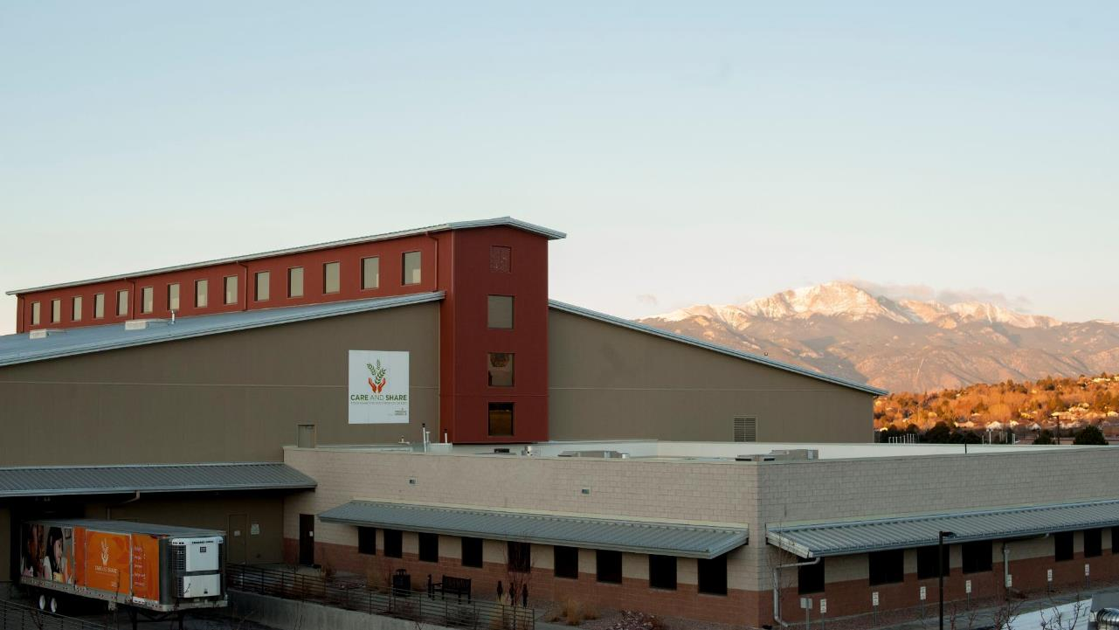
ABC’s of Food banking
High level overview

Slide 2
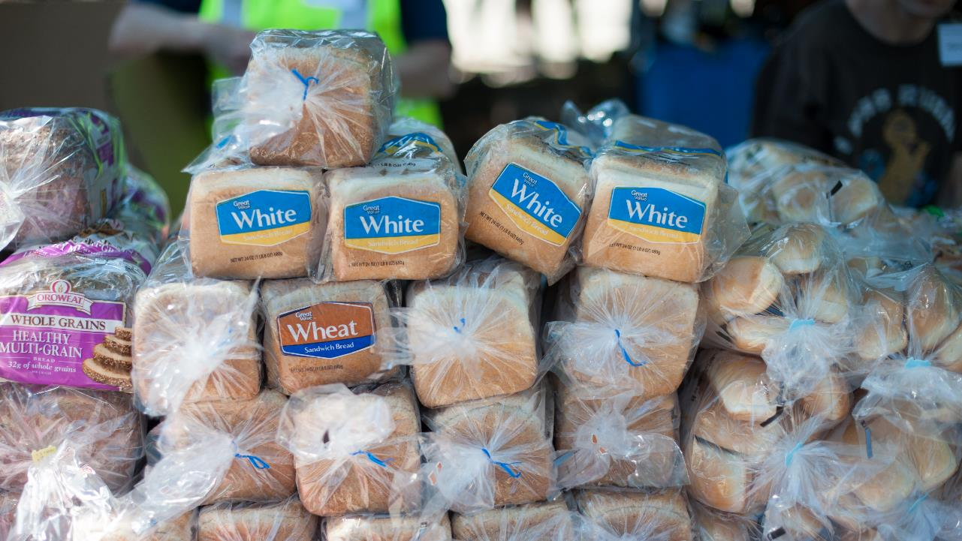
ABC’s of Food Banking
Member of Feeding America and Feeding Colorado
Where do we get our food?
Feeding America (national manufactures and growers)
Food Rescue (grocery stores, restaurants, local farmers)
Community Food Drives
Purchased Food
USDA Programs
Other Food Banks within the Feeding America Network
Notes:
Care and Share Food Bank is an affiliate of Feeding America, the largest domestic hunger relief organization. Care and Share is one of five Feeding America food
banks in the state, and the only food bank dedicated to serving the 31 counties that comprise Southern Colorado.
Feeding America has agreements with national retailers, such as Walmart and Target, to designate local food banks as the sole recipients of donated food.
Reclamation food comes from local grocery stores, restaurants, local farmers, and other businesses. This food could have damaged packaging, could be near the expiration date, or is not moving off the shelves fast enough. This is perfectly good, safe food that would otherwise go to waste.
Much of our reclamation food now is agency empowered

Slide 3
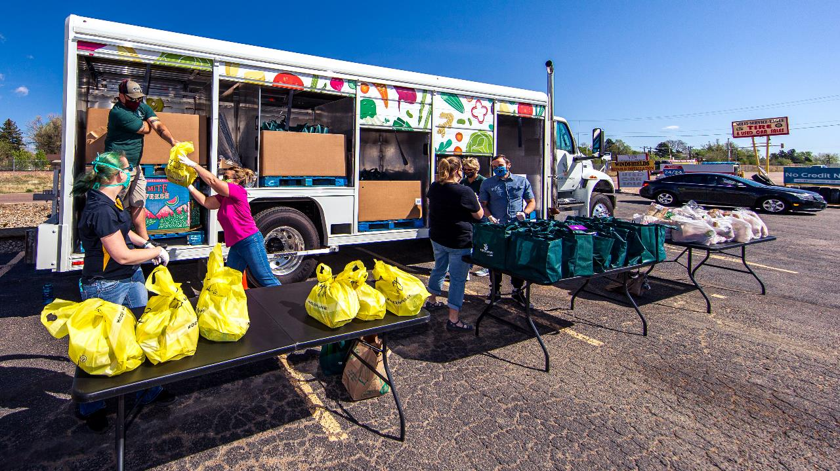
ABC’s of Food Banking: Who do we work with?
Partner Agencies, Soup Kitchens, Schools, State Partners, and Community Groups.
Programs We Operate
Mobile Food Pantries, Mobile Markets, Send Hunger Packing, School Pantries, School Snack Program… and Sunny Side Market.
Notes:
Majority of our food goes out to food pantries, soup kitchens and shelters throughout our service area.
We operate several programs directly ourselves, Mobile Food Pantries, Mobile Markets and our Kids programming.
Just as a reminder, we no longer charge for our food! Previously we would charge a shared maintenance. We still do have some items designated in our purchased food program (very few items total, currently we have 6

Slide 4
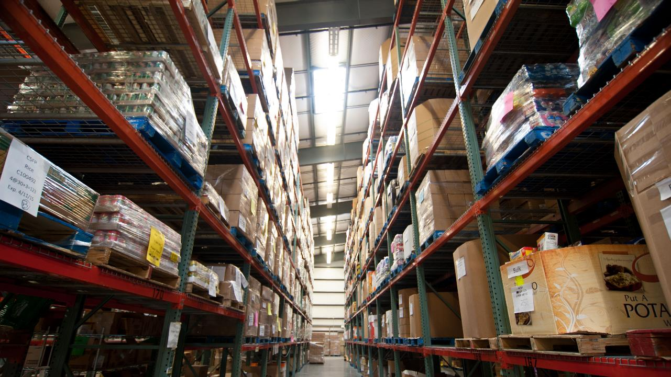
Food IN AND OUT
and how it magically
all happens

Slide 5
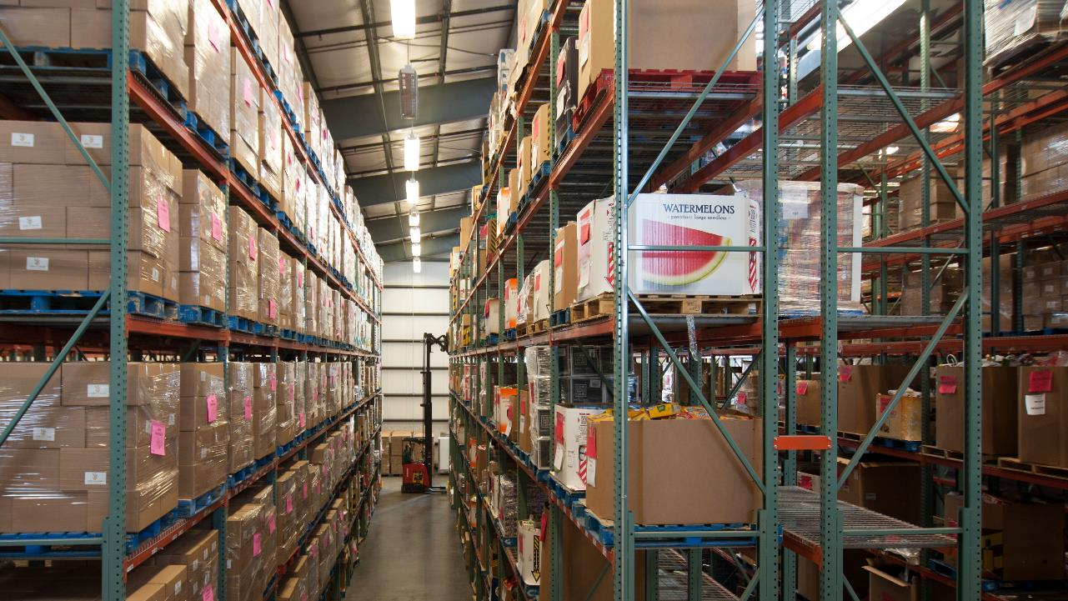
Overview of conversation today
Procuring food and what it takes to bring food into the building
What happens to the food once its here and how it gets into Ceres
How our partner agencies and programs get access to the food
Picking orders for agencies and getting that food into their hands
Paper, Paper and more Paper and where it all goes
Processes Differences in Pueblo
Audits and Compliance
Technology

Slide 6
Procuring food
1)
Food Procurement team (Jason Feld and Tricia Thomas) actively seeks and accepts loads based on food budget for donated and purchased foods.
Commodities are separate process. (More on next slide)
3) Receiving Coordinators (Kevin Westendorf and Joey Egan) check entire truck for the following: spoilage, accuracy, temperature. Once confirmed Incoming Product Donation (IPD) form is completed.
2) Product is scheduled for delivery, using an Outlook calendar, or in some cases shows up unannounced.
4) Barcoded pallet tags are created and product is stored. Donation Orders is created in Ceres.
Notes:
A donation order is documentation that is used to enter information into Ceres.
IPD’s is strictly receiving paperwork noting what was received and the state in which it was received.

Slide 7
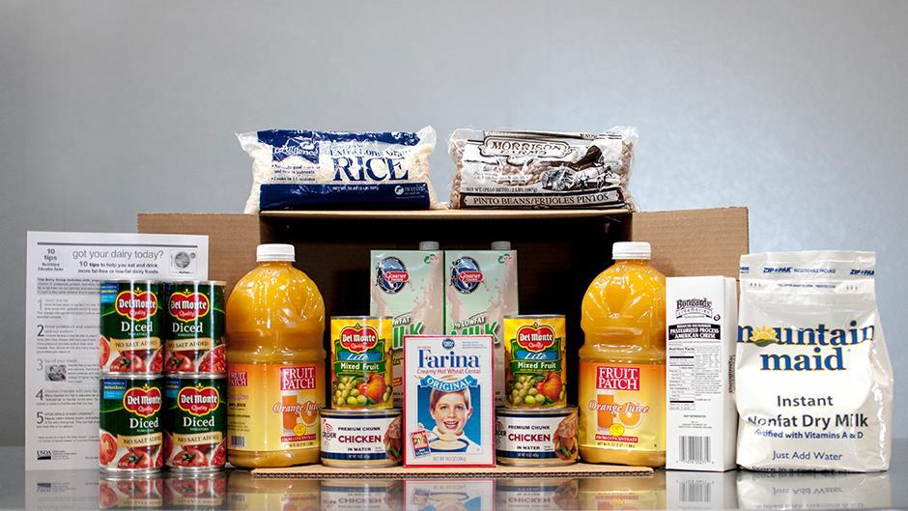
USDA Product | TEFAP and CSFP
Two different “categories” underneath the TEFAP umbrella
Entitlement: Amount determined by state, food orders placed a year in advance
Bonus: distributed in phases, state emails letting us know what is available
Product is ordered through WBSM by staff and vendor will contact us to schedule delivery with Receiving Coordinator.
Product arrives and is carefully verified inspecting product and temperatures. If there is a problem, we report the non-compliance to the State of Colorado and reject in WBSM.

Slide 8
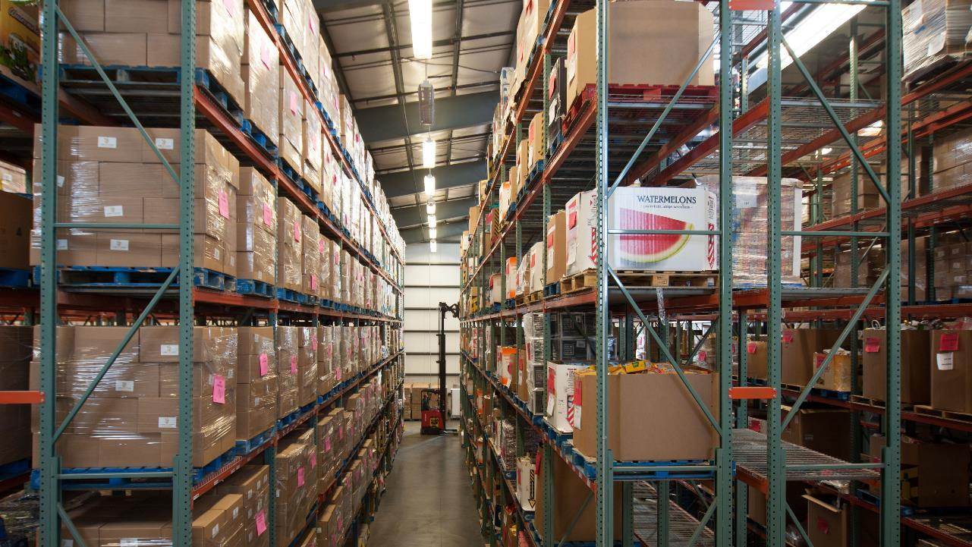
Food is now physically in the building…
but that’s literally it.

Slide 9
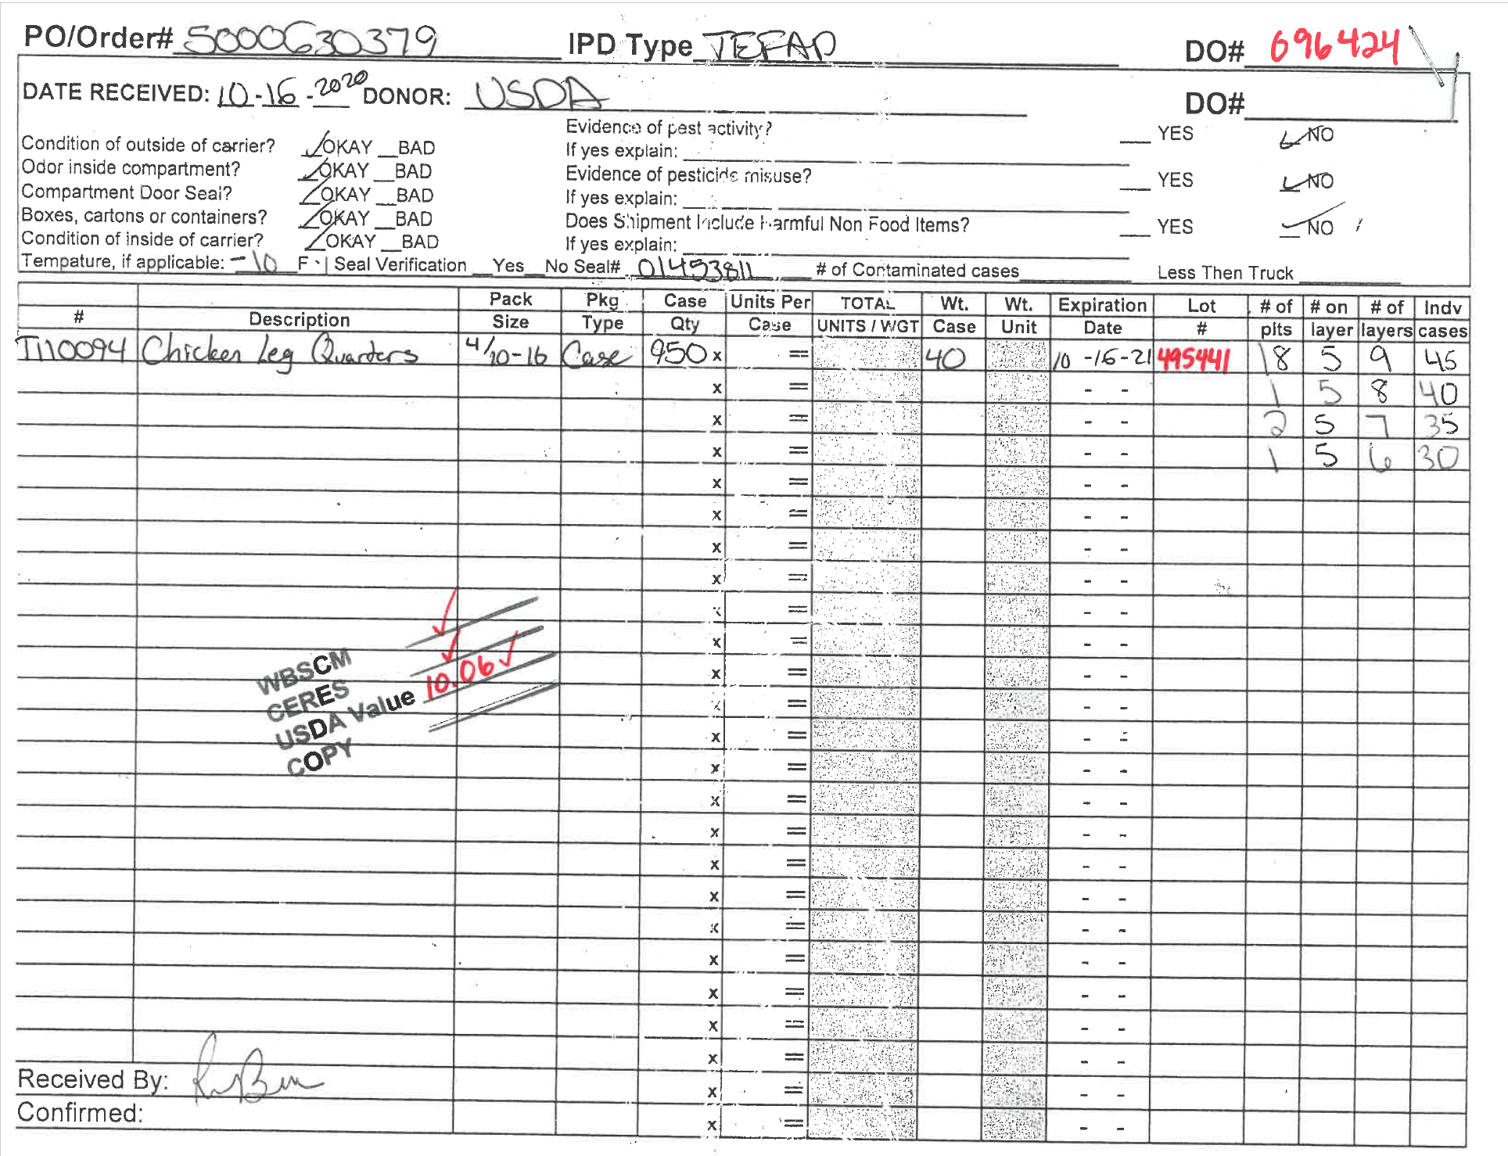
IPD- Incoming product donations forms
Given to Programs Staff
If it is commodities, Programs staff confirms receipt in WBSM
Item cards are filled out in Ceres by respective staff members using information found on IPD
Once completed, IPD is filed in Logistics Directors office.

Slide 10
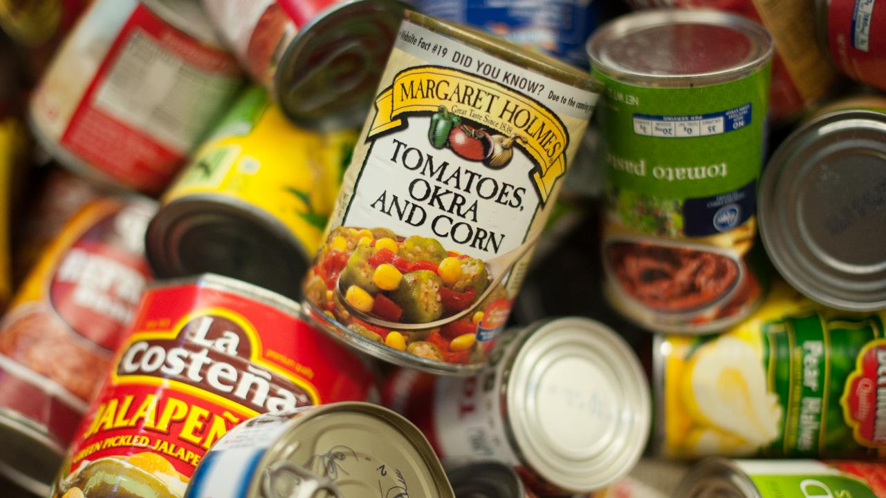
Other sources for inbound food
Food drives: Donor information form is filled out at time of donation, given to Accounting Associate (Lisa Baldomero) entered into Ceres, given to Donor Services Coordinator (Alex Torres) entered into Raisers Edge.
Starbucks: 3rd party drivers deliver weekly and place it in refrigerator for distribution. Data is then uploaded to Ceres.
Retail/Driver Pick Ups: Food is picked up, brought back to facility and sorted according to product type and weighed. Driver fills out IPD, which then goes to Accounting Associate and entered into Ceres. These relationships are managed by Food Procurement Coordinator (Tricia Thomas)
Agency Empowerment: Agency picks up food at select locations and enters information directly into MealConnect which syncs with CERES, so it goes “in” and “out” of the system automatically.
Notes:
Agency Empowerment- this food NEVER touches our building

Slide 11
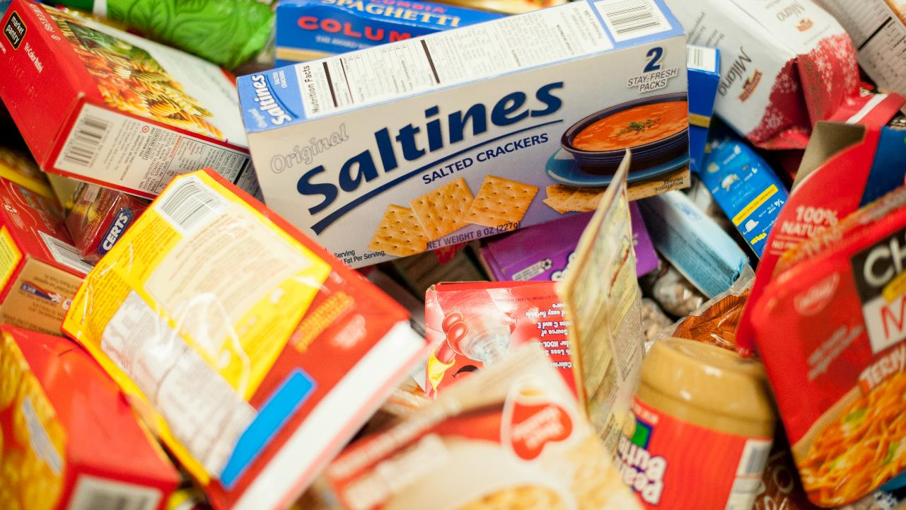
BULK CATEGORIES
Bulk food, donated food, and secured mixed loads… are all categorized
201*/202/203: Bread, Pastry, Bimbo
301*: Assorted Produce
506*: Assorted Meat
506B: Boxed; 506X: Bulk
700: Prepared Foods (Starbucks)
701: Repack Items (more on next slide)
703: Non-Food
705*: Bulk Food Drive
705B: Boxed; 705X: Bulk; 705D: Disaster; 705F: Family Food Box Program
803: Assorted Frozen
Sorted by Volunteers and turned into 807:Boxed Frozen and 808: Ice Cream/Popsicles
804: Dairy
805: Assorted Refrigerated
*All categories have a “Not Fit for Human Consumption” category and given to farmers

Slide 12
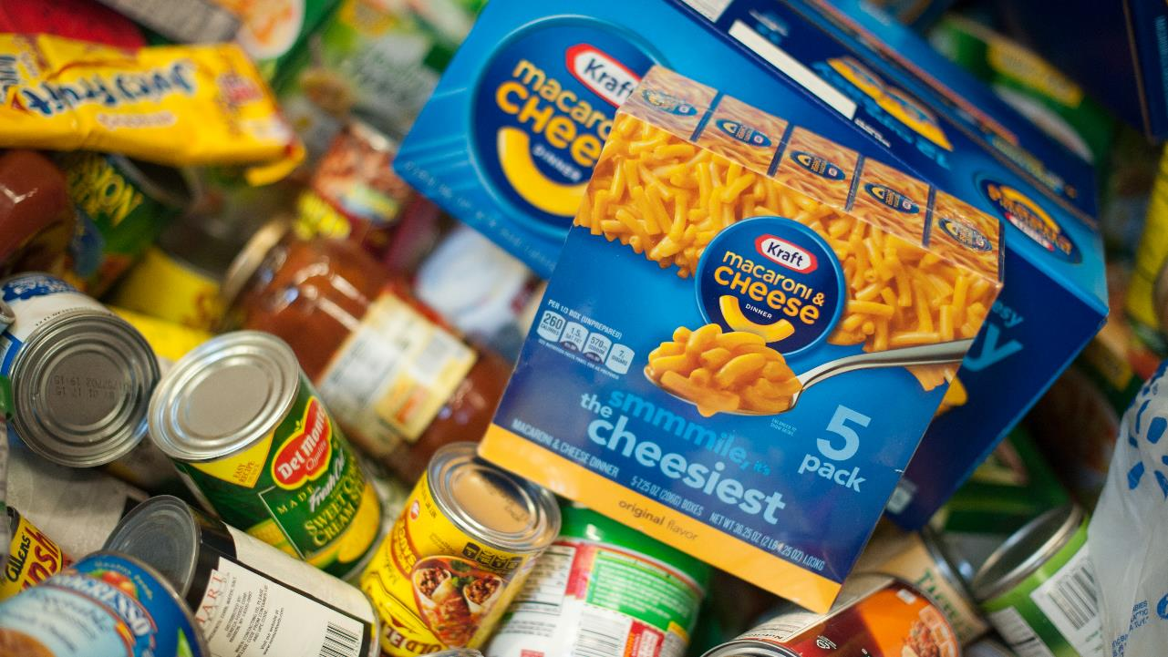
701… what?
Through the power of volunteers, we sort 701 into the following categories.
701B: Boxed Dry Goods
704: Assorted Drinks
704W: Water
709: Snacks
714: Baby Food
715: Boxed Dry Goods (no cans)

Slide 13
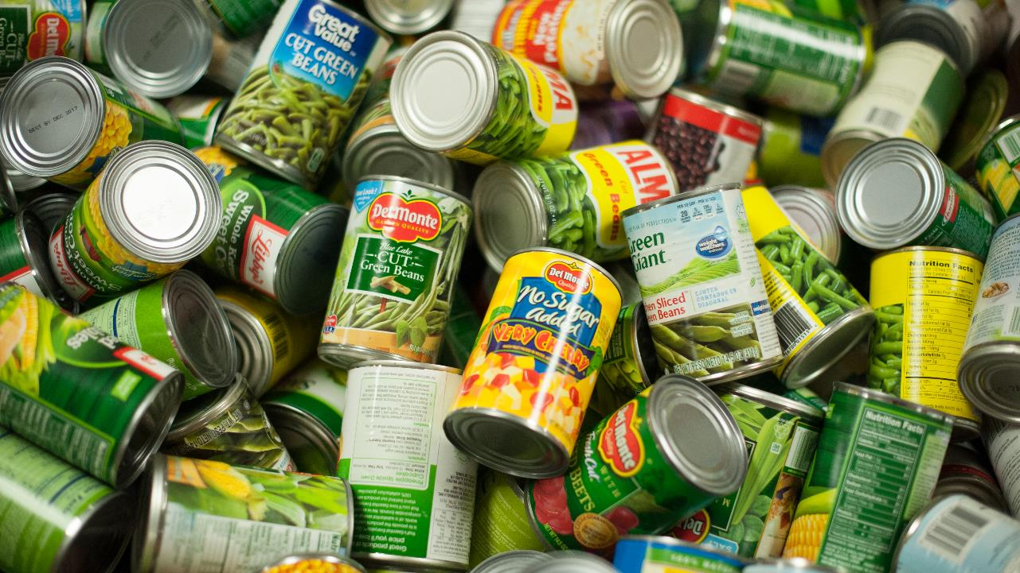
Bulk Categories
705: Food Drive food that is received by the community is sorted into the same categories as 701. It’s all folded together, starting in January 2021.
As much as possible we’ll be making this items available as “cases” with an average case weight and eliminating ordering by pounds as much as possible.
Perishible bulk items and short-dated items like 301/804/805 product received from retail donors has largely been distributed through direct services since COVID but may be available a la carte for pickups and deliveries in the next fiscal year. This is heavily dependent on the CMOBILE technology upgrades.

Slide 14
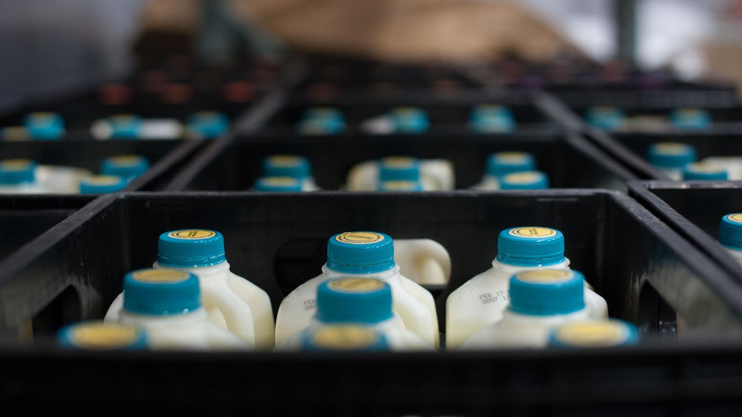
OTHER CATEGORIES
5 # # # #: Donated Items
59 # # #: Vegetables by the case (Onions, Carrots and Potatoes)
6 # # # #: CNI Food (School Pantry, Send Hunger Packing, Snacks)
8 # # # #: Purchased Food
T # # # # # : The Emergency Food Assistance Program (TEFAP)
C # # # # #: Commodity Supplement Food Program (CSFP)

Slide 15
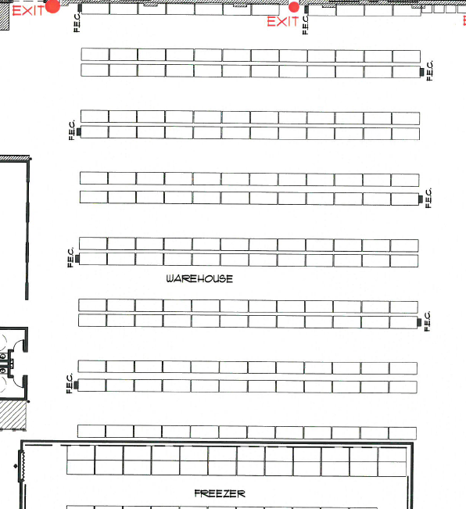
7
6
5
4
Donated/Purchased/Pick Line
Direct Services
TEFAP
CSFP
CNI
Donated/Purchased/Pick Line
Pending Outbound Orders
3
2
1

Slide 16
Food is now physically in the building…
AND in Ceres

Slide 17
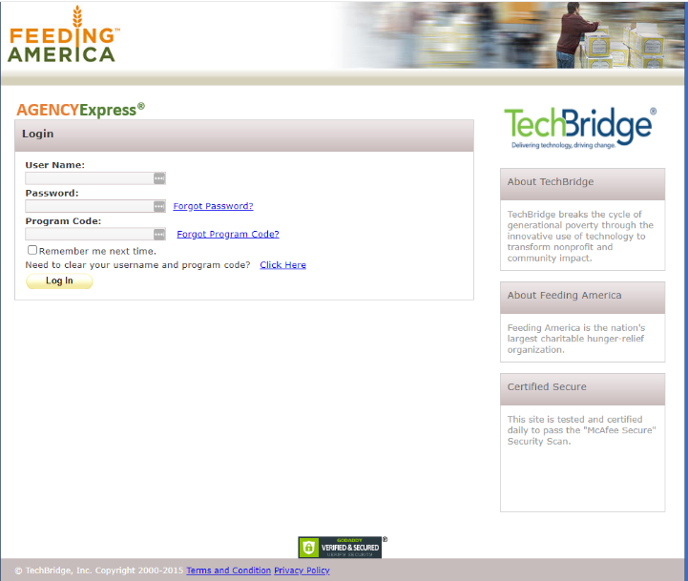
Ready to be ordered!
At this point, all the food is in inventory, and has been sorted.
Inventory is reflected on Agency Express, the online platform that our partners use to place orders.

Slide 18
Agency Express
Jump Over to AE
https://www.agencyexpress3.org/AgencyExpress30/NewLogin.aspx

Slide 19
Agency programs
Some agencies are just food pantries, but some agencies have multiple programs- they might operate a food pantry and distribute TEFAP and CSFP and also operate a soup kitchen. Because we have to track each program in a different way, each program has an agency card and create orders for each program.
In this scenario, the one agency will have an order for the food pantry, one for TEFAP and one for CSFP for soup kitchen. That means, each order could theoretically produce multiple pallets of food that are only half full.

Slide 20
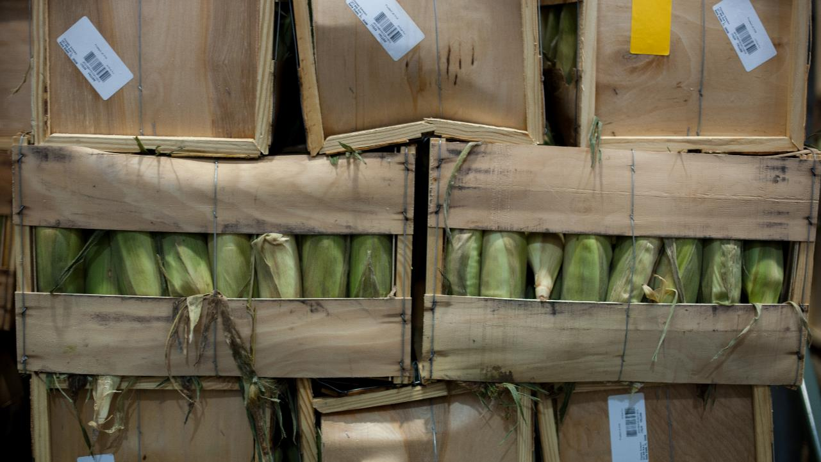
TEFAP Allocation
TEFAP: Programs Manager (Tabi Rackley) allocates food to our partners who have agreed to take this product. The inventory that we have is fairly allocated through an Access Database, an email is sent to the partners informing them of their allocation and they either accept or refuse the product and quantities noted.
Partner Agency returns allocation with notations, via email and a volunteer places the order in Ceres.

Slide 21
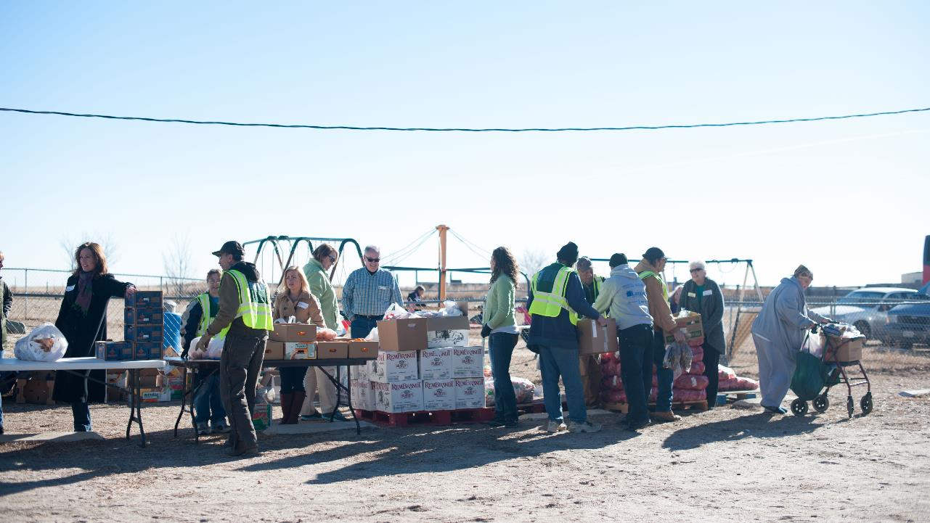
Processes specific to programs - Mobile food pantries
Mobile Food Pantries are managed by the Direct Services Manager (Steven Williams). He places orders well in advance of the mobile, consulting both the pounds budget and the historic numbers of neighbors served through each mobile. Based on inventory availability, the order is placed.
Mobile Food Pantries are often a mechanism for us to push out product that we have an abundance of or is short dated.

Slide 22
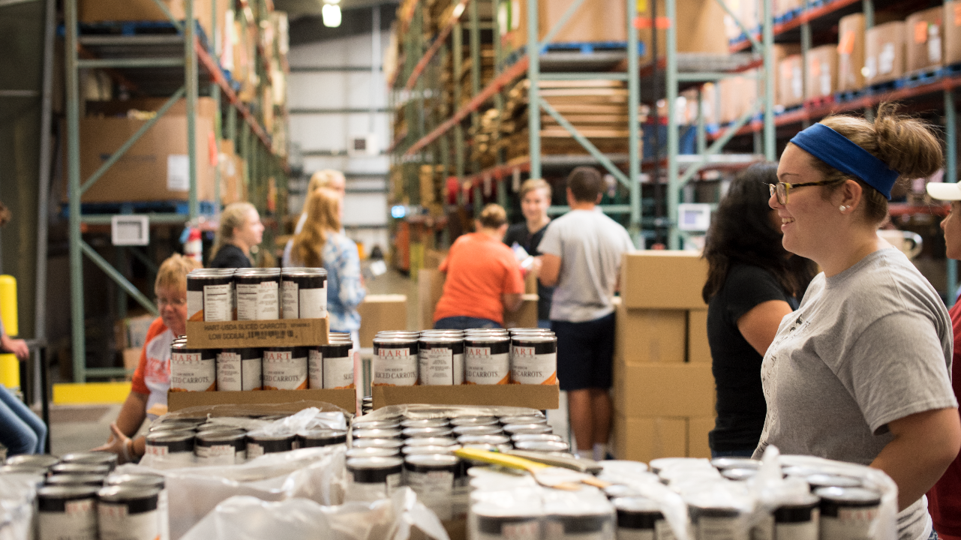
Processes specific to programs - CSFP and SHP
A “kit” is a box variety of individual items combined into a single box for easy distribution
Kits are distributed primary through the CSFP and SHP programs.
Kitting allows the food bank to take individual units and combine them in a box physically while maintaining accuracy and visibility in the Ceres system.

Slide 23
All food is now on orders, and ready to be picked.

Slide 24
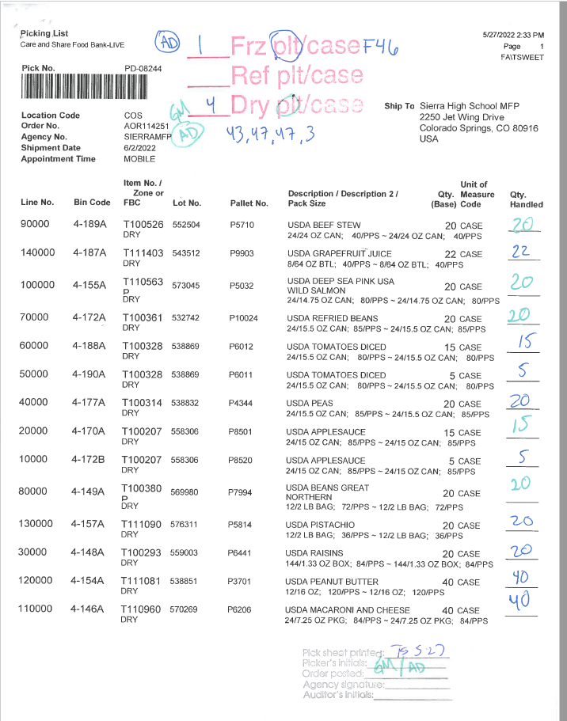
Pick sheets
Pick Sheets are printed by Colorado Springs Distribution Center Manager (Tom Sweet) daily at 3pm based on the lead time we’ve established for orders:
Pick Ups: 2 Business Days
Deliveries: 6 Business Days
Pick Sheets are put in a hanging file near the pick table for the Distribution Center Associates to work through each day.
The DCA’s will pick the order and note on the pick ticket where they’ve placed it for staging.
If it’s a pickup, it will have a white tag on it, and if it’s a delivery, it’ll have a pink tag.

Slide 25
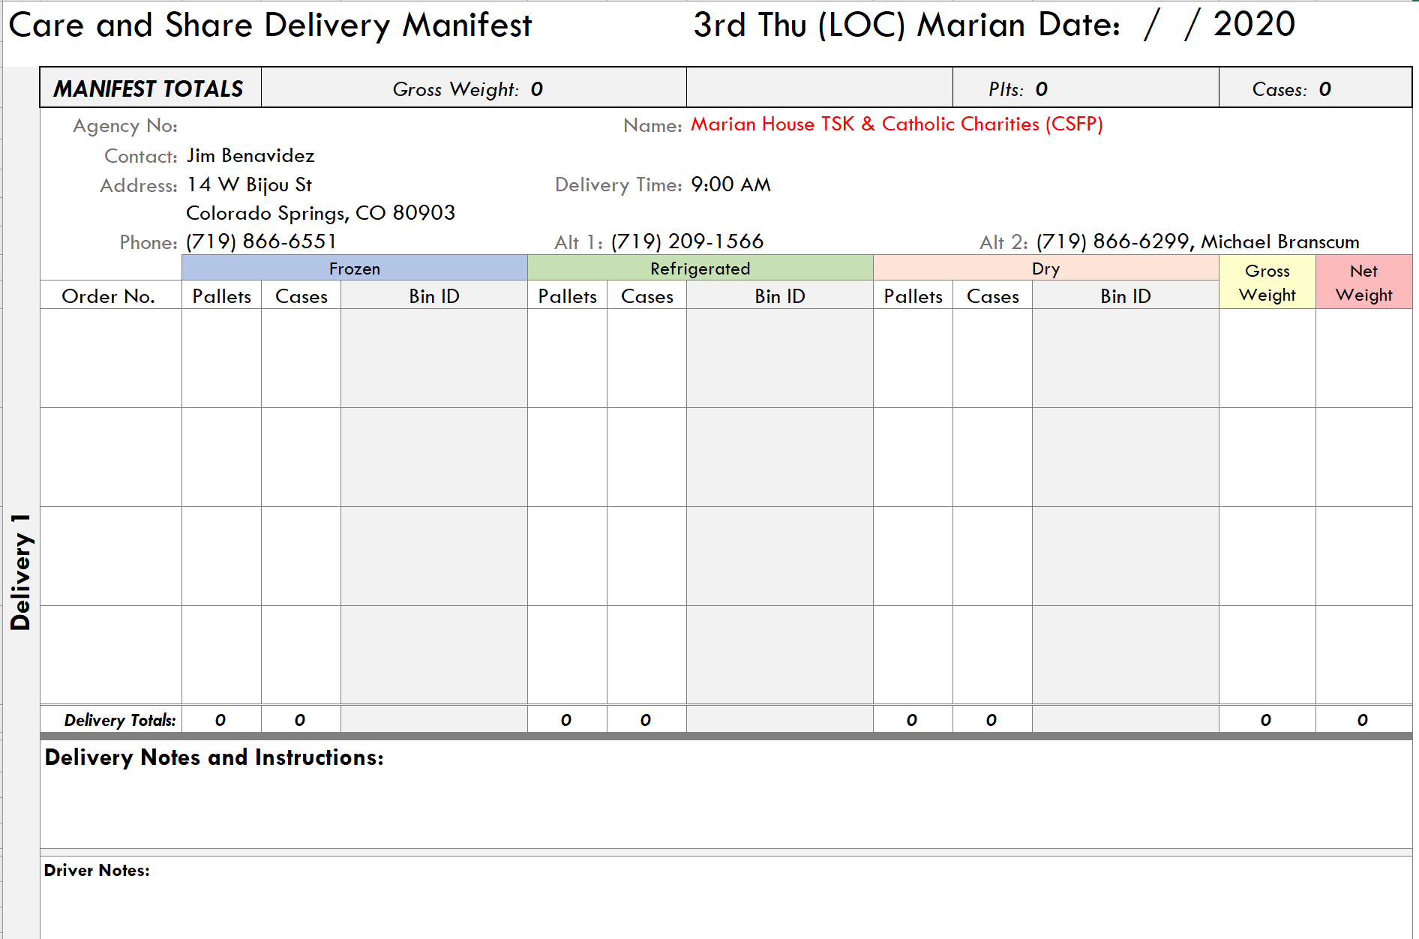
Manifest-deliveries ONLY
Once an order is picked and is destined for delivery, the pick sheets are given to Accounting Associate (Lisa Baldomero) and a manifest is created with the following information.

Slide 26
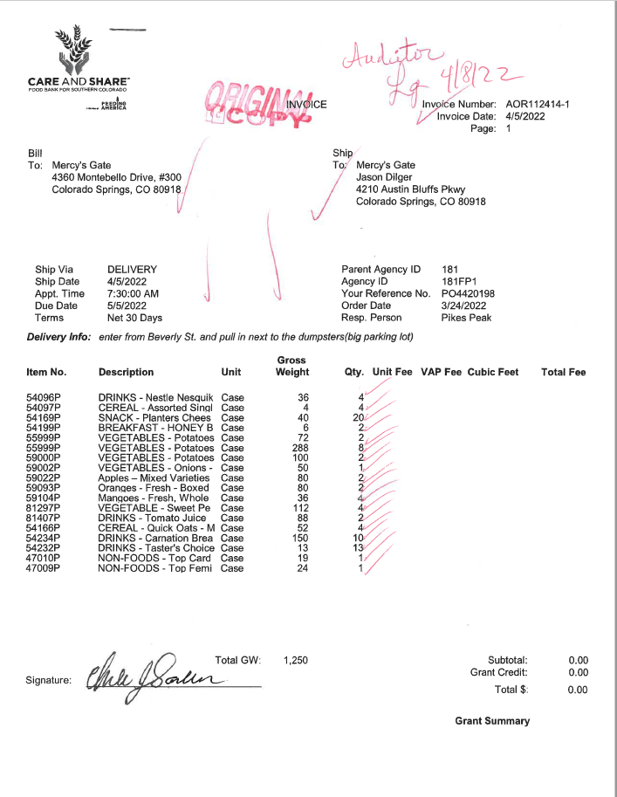
Invoices
Pick Ups: Agency Check Out Volunteers retrieve from pick table area, create invoice once agency comes to pick it up.
Delivery: Accounting Associate, while generating the manifest, generates the invoice.

Slide 27
Pick Sheet, Manifest and invoice
PICK UPS
Agency Check Out Volunteers generate invoice after pickup and have agency sign pick sheet.
Invoice is married with the pick sheet.
DELIVERIES
Pick sheet, manifest and invoice are given to Transportation Manager (Wil Embry). The invoice and manifests are given to the Over the Road Drivers (Taylore Thomas, Scott Clipner, Denny Toner, Mike Kinzie, Lawanna Whittington). Invoices are signed by agency at time of delivery.
Upon return, OTR will give signed invoice back to Transportation Manager and is married back with the pick sheet.

Slide 28
Pick Sheet, Manifest and invoice
Invoices and Pick Sheets in both scenarios are audited by volunteers to ensure that pounds were accurately recorded. If errors (overage/shortage) are found, separate processes are followed.
Overage: Agency Return Order is completed, if it’s a shortage, a supplemental order is created. Once the first audit is completed, items are filed on mezzanine.
A second audit is conducted at month end to ensure that all Agency Orders are present according to master agency order list.

Slide 29
Now, the food is in the hands of our neighbors who need it most.

Slide 30
Paper, paper and more paper- where does it all go?
Incoming Product Donation (IPD): Receiving Coordinator gives to Programs Staff, then filed in Logistics Directors Office
Donor Information Form: Agency Check Out volunteers give to Accounting Associate (Ceres), then given to Donor Services Coordinator (Raisers Edge) and filed.
Donation Order and Purchase Orders: Connected to the IPD and filed.
Pick sheet and invoices are filed on the mezzanine

Slide 31
pueblo
Product is received into the Pueblo facility is processed identically with the staff there.
Distribution Center Manager orders and stocks dry goods out of Colorado Springs inventory and transferred weekly.
IPD’s/DO/PO are kept at facility and filed.
Invoices and pick sheets from Pueblo Distribution Center and brought to Colorado Springs for auditing and filing on the mezzanine monthly.

Slide 32
Audits - financials
Annual
Operations Impact: Audits will check our work to ensure the following things…
Pick sheets are signed indicating that what we’ve said has been placed on an order has in fact left the building.
Invoice is signed indicating the inventory that we said left the building was in fact received by our partner.
Inventory reconciliation ensuring that we say is in inventory is in fact on hand.
Programs Impact
Contracts for the programs we operate, list of partner agencies
Administration Impact
Immeasurable… Team does a great deal for the financial audit

Slide 33
Audits- USDA TEFAP and CSFP
Annual
Operations Impact
Inventory reconciliation ensuring that we say is in inventory is in fact on hand.
TEFAP and CSFP pick sheets and invoices
Pest control, temperature logs, cleaning logs, health and fire inspection reports
Programs Impact
Agency agreements, Civil Rights training, 501c3 compliance
CSFP client files
TEFAP sign in forms
Administration Impact
Reimbursement claims

Slide 34
Audits AIB and Feeding America
AIB Audit (Every two years)
Primary focus on AIB is cleanliness of warehouse but also includes food safety practices.
Pest control, temperature logs, cleaning logs, health and fire inspection reports
Feeding America Compliance Audit (every two years)
Ensure compliance to the member contract
Compliance ranges from pounds in each of our counties, to brand representation, to partner agency agreements, reimbursements… literally everything that we do.

Slide 35
What the Tech?

Slide 36
Technology Upgrades so far
In 2019 We began planning for our CERES technology upgrade.
This is the biggest technology upgrade in Care and Share’s History.
While our operation had grown immensely in our 50-year history, our inventory control had not.
To support the new functionality, it was first necessary to upgrade from CERES 2009 to CERES 5.1 which happened in June 2020.
In December of 2020, we began tracking kits in CERES
This gave us visibility on what items are “in boxes” and which are still on pallets
In July of 2021, the first barcoded pallets were received into our warehouse
This was initially piloted with commodities (TEFAP and CSFP) and later incorporated to other programs
In April of 2022 we began the last conversion on our bulk items like produce and food drive donations.
All of these upgrades were completed without having to pause service to our neighbors.

Slide 37
Technology: On the Horizon
Manifesting from CERES
Manifesting currently is manually input into excel document for drivers
Manifesting from CERES will reduce the opportunity for human error and miscommunication.
Cmobile (Driver-side technology)
A la carte orders for pickups and deliveries
Allows for the collection of digital signatures for invoices
We are hoping to have the technology available Q1 FY23
Barcoded pallets tags for agency orders
Will add similar visibility to what we currently have with inbound product
Will help increase accuracy help reduce errors and the timeline to “catch” mistakes

Slide 38
Questions?

