Slide 1
Send Hunger Packing Training

Slide 2
New: COVID-19 Guidelines
Due to procurement of food at this time, the shelf stable items you receive this year may look different from previous years. Please know we are doing our best to order the best quality items for your students
If you need help brainstorming how to safely to distribute food to your students in need, please feel free to reach out to your Regional Manager.

Slide 3
New: Reporting
Numbers for Send Hunger Packing are recorded and reported monthly.
All records (monthly numbers and delivery receipts) must be kept on file for 3 years.
Submit reports through link provided by the 3rd of the following month.
https://docs.google.com/forms/d/e/1FAIpQLSdygcc9uRnu60IC46cCdO9cVx21urWnbm6Wc7QffcGCTAbFNQ/viewform?usp=sf_link
Failure to submit timely reports may result in temporary suspension of program partnership.
Your Care and Share Regional Manager will provide training on reporting in August, along with your sites individual program code.
The Send Hunger Packing Program is funded entirely through donations and grants. The information you send to Care and Share allows us to track the number of children the program serves. Stories of how this program has helped children and their families are invaluable when we report back to our funders and pursue additional funding.

Slide 4
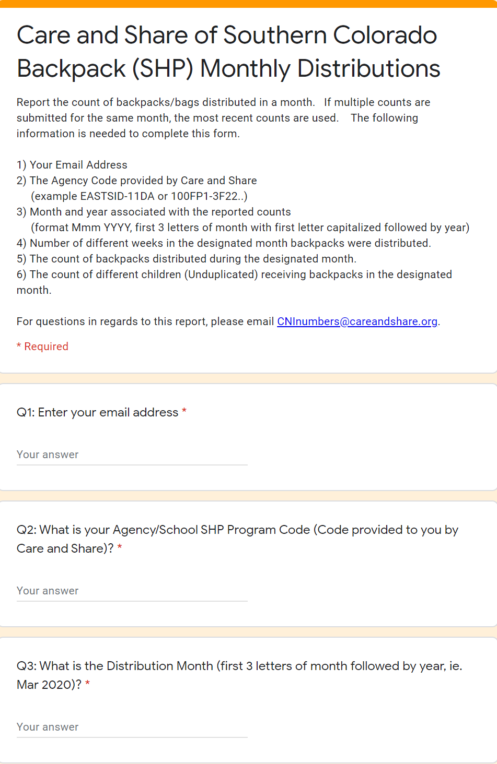
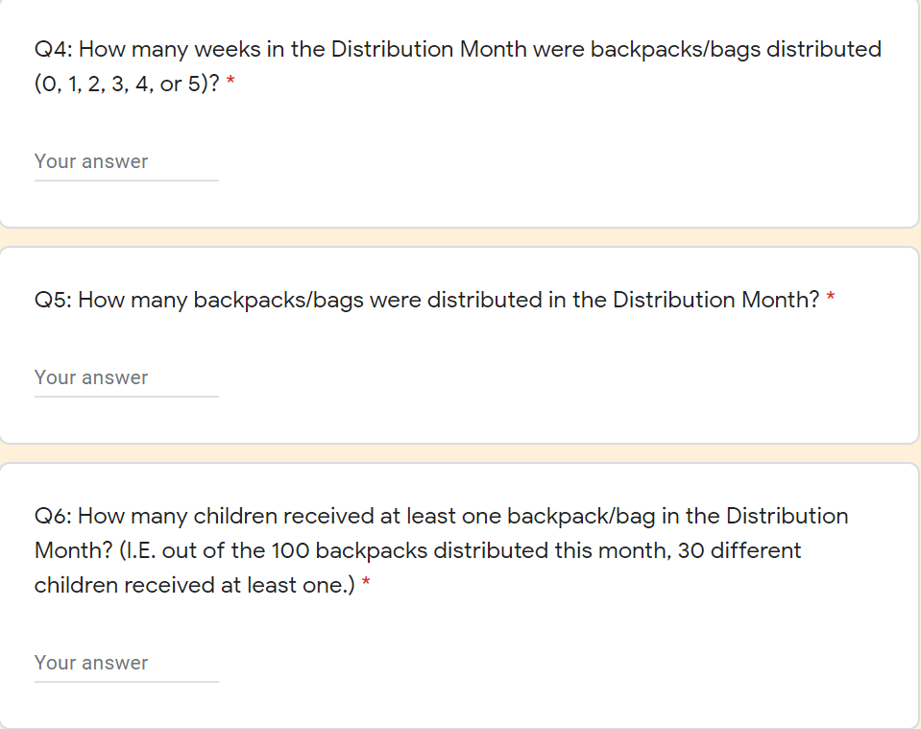

Slide 5
What is Send Hunger Packing?
The mission of the Send Hunger Packing program is to help alleviate child hunger through the provision of food to children and families at school.
Send Hunger Packing provides bags of non-perishable and easily-consumable food to hungry children and their families to consume over the weekend when other resources are not available. The bags are discreetly distributed to children before the weekend.

Slide 6
Getting Started
Required Paperwork
Send Hunger Packing Agency Agreement
Signed copy of Background Check Policy
ServSafe Food Handler Certificate
Parent letter/permission slip sent home
Signed permission slips returned-Must be kept on file at site
Identify any allergies/special diet requirements from permission slips. If allergies exist, manage that child’s backpack for appropriate food options.
Notes:
Do we need a list of participant names?

Slide 7
Site Coordinator Responsibilities
Communicating with their Care and Share Regional Manager
Distributing bags discretely
Managing participation, referrals, parental consent, etc.
Reporting numbers monthly
Ensuring distribution of all allocated bags each week
Communicating food allergy substitution needs
Ensuring proper storage of food
Providing program feedback (including surveys and evaluations)

Slide 8
Identifying Program Participants
Rushing food lines
Extreme hunger, especially on Mondays
Quickly eating all food and asking for more
Asking when the next meal will be served
Regularly requesting food
Saving/hoarding/stealing food to take home
Comments about not having enough food at home
Physical appearance, school performance, and home environment

Slide 9
Receiving Food
Bags will be picked up (or bi-weekly if the site has adequate storage), or delivered monthly for distance sites
Provide extra product counts to Care and Share by the 3rd of each month (in case of weather closure, etc.)
Communicate any changes in number of participants to Care and Share as soon as possible so that food quantities can be adjusted (if available)
Communicate any new food allergies or restrictions to Care and Share as soon as possible so that prohibited foods can be avoided

Slide 10
Receiving Food
If receiving delivery, please arrange for two people to meet the driver and help unload
Sign the delivery receipt that goes back with the Care and Share driver and keep your copy on file for 3 years
It is the site’s responsibility to properly put away food upon receipt
If picking up at Care and Share’s distribution center, please ensure timely storage of food. Food cannot be stored in cars or for lengthy periods of time in extreme heat or cold. This affects the expiration dates of food and can cause food safety issues.

Slide 11
Food Storage
All food must be stored at least 6 inches off the ground (on a pallet or shelf), 2 inches away from the wall, and 6 inches from the ceiling
Food must be stored away from cleaning materials and toxic chemicals
Storage area should be clean, dry, and free of pests
Place thermometers in all storage areas
The storage area should be locked when not in use
FIFO: Foods should be rotated to ensure oldest product is used first

Slide 12
Food Safety
Site Coordinators must be ServSafe Certified and follow proper food handling guidelines presented in the Food Handler course
Site Coordinators should train all pantry volunteers on guidelines
Food must be stored appropriately
Dry Food: 50 – 70 degrees

Slide 13
Food Distribution
Bags should be distributed weekly to children
Confidentiality of children must be maintained
Preferred distribution method is for bags to be distributed while students are out of the room. Another option is to have students stop by the guidance counselor or nurse’s office at the end of the day.
Sites should distribute one bag per child. Any extra bags should be held for distribution the following week.
Notify Care and Share of any changes in number of bags needed at the site

Slide 14
Questions?

